Slide 1


Reproduce 「POSTER: AFL-based Fuzzing for Java with Kelinci」
Rody Kersten, Kasper Luckow, Corina S. Păsăreanu
October 2017, ACM CCS’17
Proceedings of the 2017 ACM SIGSAC Conference on Computer and Communications Security
Presented by WU WEI-CHENG
wulearn.cs09g[at]nctu.edu.tw

Slide 2

Outline
01. INTRODUCTION
02. OVERVIEW
03. EVALUATION
04. RELATED WORK
05. DISCUSSION
06. CONCLUSION

Slide 3

01.
INTRODUCTION

Slide 4
INTRODUCTION
Motivation:

Slide 5
INTRODUCTION
Motivation:
1. Previous homework has done AFL to recover from bugs

Slide 6
INTRODUCTION
Motivation:
1. Previous homework has done AFL to recover from bugs
2. Has been generally clear the AFL workflow

Slide 7
INTRODUCTION
Motivation:
1. Previous homework has done AFL to recover from bugs
2. Has been generally clear the AFL workflow
3. How the AFL supports in other languages?

Slide 8
INTRODUCTION
Motivation:
1. Previous homework has done AFL to recover from bugs
2. Has been generally clear the AFL workflow
3. How the AFL supports in other languages?

Slide 9


INTRODUCTION
Black-box
White-box

Slide 10
INTRODUCTION
AFL :

Slide 11
INTRODUCTION
AFL :
Introduced by google

Slide 12
INTRODUCTION
AFL :
Introduced by google
A pioneer in coverage-guided

Slide 13
INTRODUCTION
AFL :
Introduced by google
A pioneer in coverage-guided
However, it has not been updated since 2017

Slide 14
INTRODUCTION
AFL :
Introduced by google
A pioneer in coverage-guided
However, it has not been updated since 2017

Slide 15
INTRODUCTION
AFL Workflow:

Slide 16
INTRODUCTION
AFL Workflow:
Instrument from source code compilation to record Code Coverage

Slide 17
INTRODUCTION
AFL Workflow:
Instrument from source code compilation to record Code Coverage
Select some input files and add them to the input queue as the initial test set

Slide 18
INTRODUCTION
AFL Workflow:
Instrument from source code compilation to record Code Coverage
Select some input files and add them to the input queue as the initial test set
"Mutation" of the files in the queue according to a certain strategy (Bitflip, Arithmetic, Interest, Dictionary, Havoc, Splice)

Slide 19
INTRODUCTION
AFL Workflow:
Instrument from source code compilation to record Code Coverage
Select some input files and add them to the input queue as the initial test set
"Mutation" of the files in the queue according to a certain strategy (Bitflip, Arithmetic, Interest, Dictionary, Havoc, Splice)
After mutation, if the file updates the coverage, it is added to the queue

Slide 20
INTRODUCTION
AFL Workflow:
Instrument from source code compilation to record Code Coverage
Select some input files and add them to the input queue as the initial test set
"Mutation" of the files in the queue according to a certain strategy (Bitflip, Arithmetic, Interest, Dictionary, Havoc, Splice)
After mutation, if the file updates the coverage, it is added to the queue
The above process will continue in a loop, during which the file that triggered the crash will be logged

Slide 21
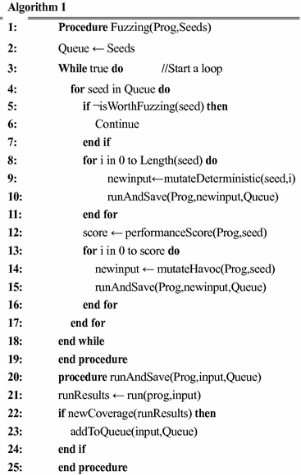
INTRODUCTION
AFL Workflow:
Instrument from source code compilation to record Code Coverage
Select some input files and add them to the input queue as the initial test set
"Mutation" of the files in the queue according to a certain strategy (Bitflip, Arithmetic, Interest, Dictionary, Havoc, Splice)
After mutation, if the file updates the coverage, it is added to the queue
The above process will continue in a loop, during which the file that triggered the crash will be logged

Slide 22
INTRODUCTION
AFL Architecture:

Slide 23
INTRODUCTION
AFL Architecture:
Input file
Input queue
Input file
Mutate
Input file
target program
Input file
Y
N
New path

Slide 24
INTRODUCTION
Kelinci :

Slide 25
INTRODUCTION
Kelinci :
- Means “rabbit” in Indonesian

Slide 26
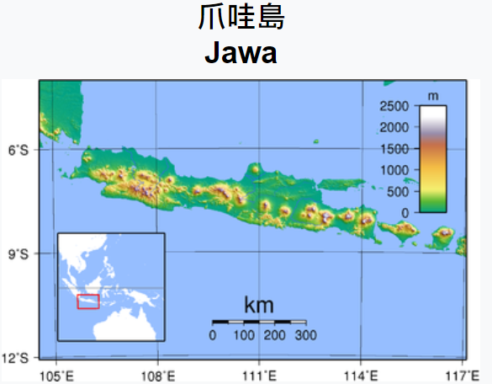

INTRODUCTION
Kelinci :
- Means “rabbit” in Indonesian

Slide 27
INTRODUCTION
Kelinci :
- Means “rabbit” in Indonesian
- AFL-style fuzzing

Slide 28
INTRODUCTION
Kelinci :
- Means “rabbit” in Indonesian
- AFL-style fuzzing
- Instrumentor
- Server

Slide 29
INTRODUCTION
Kelinci :
- Means “rabbit” in Indonesian
- AFL-style fuzzing
- Instrumentor
- Server

Slide 30
INTRODUCTION
Common Java Vulnerabilities :

Slide 31
INTRODUCTION
Common Java Vulnerabilities :
- Functional Bugs

Slide 32
INTRODUCTION
Common Java Vulnerabilities :
- Functional Bugs
- Uncaught exceptions
- Assertions
- Inconsistent Implementations

Slide 33
INTRODUCTION
Common Java Vulnerabilities :
- Functional Bugs
- Uncaught exceptions
- Assertions
- Inconsistent Implementations
- Security Issues

Slide 34
INTRODUCTION
Common Java Vulnerabilities :
- Functional Bugs
- Uncaught exceptions
- Assertions
- Inconsistent Implementations
- Security Issues
- Infinite Loops
- OutOfMemoryError
- SQL injections
- XSS (Framework, Sanitizers, …)
- RCE (Jakarta, Serialization, …)
- ...

Slide 35
INTRODUCTION
Common Java Vulnerabilities :
- Functional Bugs
- Uncaught exceptions
- Assertions
- Inconsistent Implementations
- Security Issues
- Infinite Loops
- OutOfMemoryError
- SQL injections
- XSS (Framework, Sanitizers, …)
- RCE (Jakarta, Serialization, …)
- ...

Slide 36
02.
OVERVIEW

Slide 37
OVERVIEW
Target app
Instrumentor
Interface.c
TCP
Server
fork()
fork()
fork()
fork()
fork()
fork()
…
AFL
Instrumented
target app
Fuzzer / C side
Java side

Slide 38
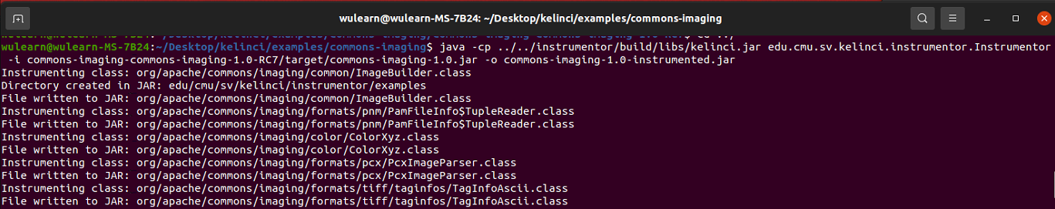
OVERVIEW
Instrumentor :

Slide 39
OVERVIEW
Instrumentor :
AFL-style

Slide 40
OVERVIEW
Instrumentor :
AFL-style
Has path collision

Slide 41
OVERVIEW
Instrumentor :
AFL-style
Has path collision
Coverage is not actual

Slide 42
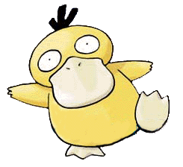
OVERVIEW
Instrumentor :
AFL-style
Has path collision
Coverage is not actual
cur_location = <COMPILE_TIME_RANDOM>;
shared_mem[cur_location ^ prev_location]++; prev_location = cur_location >> 1;

Slide 43
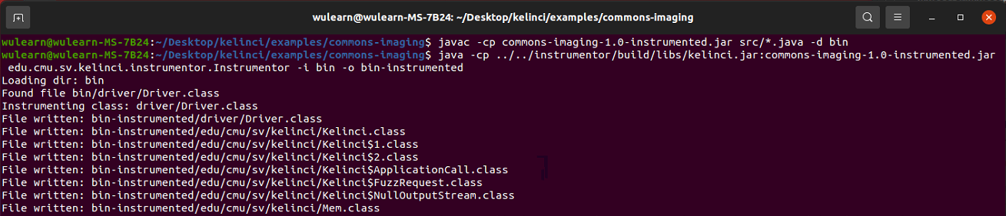
OVERVIEW
Instrumentor :
AFL-style
Has path collision
Coverage is not actual
cur_location = <COMPILE_TIME_RANDOM>;
shared_mem[cur_location ^ prev_location]++; prev_location = cur_location >> 1;
Mem.mem[id^Mem.prev_location]++; Mem.prev_location = id >> 1;

Slide 44
03.
EVALUATION

Slide 45

Run on
Linux 20.04
With
Intel(R) Core(TM)
i5-8400 CPU @ 2.80GHz
6-Core Processor

Slide 46
Target

Slide 47

Target
APACHE COMMONS IMAGING

Slide 48
Target
APACHE COMMONS IMAGING
release candidate 7 (commons-imaging-1.0-RC7)
on 24 Nov 2013 (Note: the next release: Oct 2018)

Slide 49
Target
APACHE COMMONS IMAGING
release candidate 7 (commons-imaging-1.0-RC7)
on 24 Nov 2013 (Note: the next release: Oct 2018)

Slide 50
Instrumentor

Slide 51
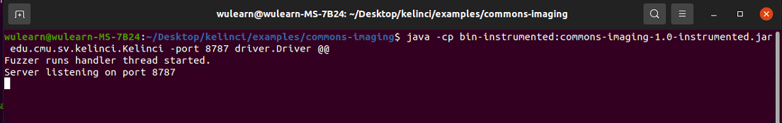
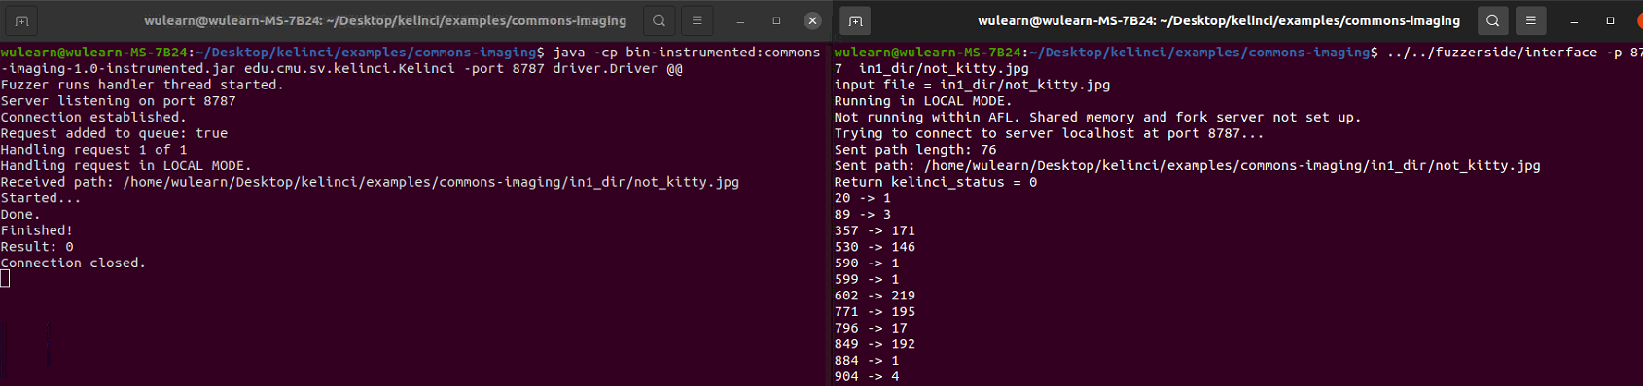
Run Server

Slide 52
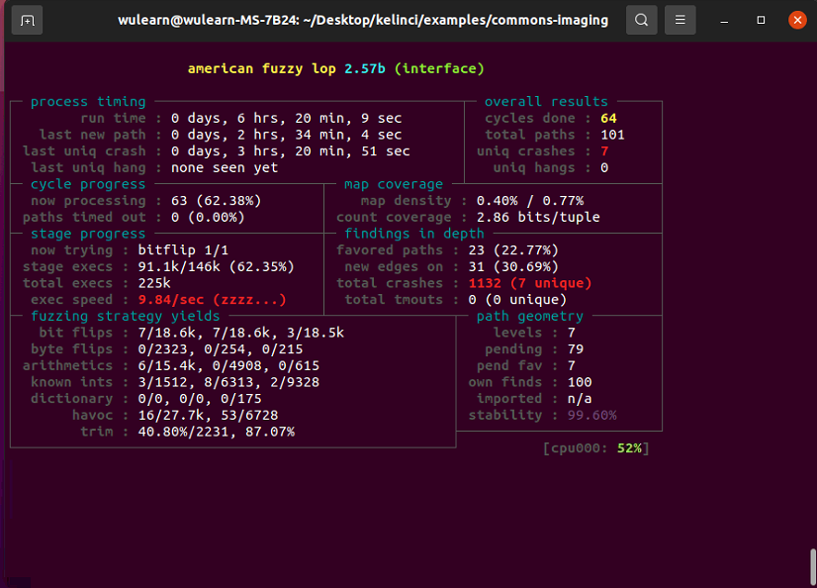
Run Fuzzer

Slide 53
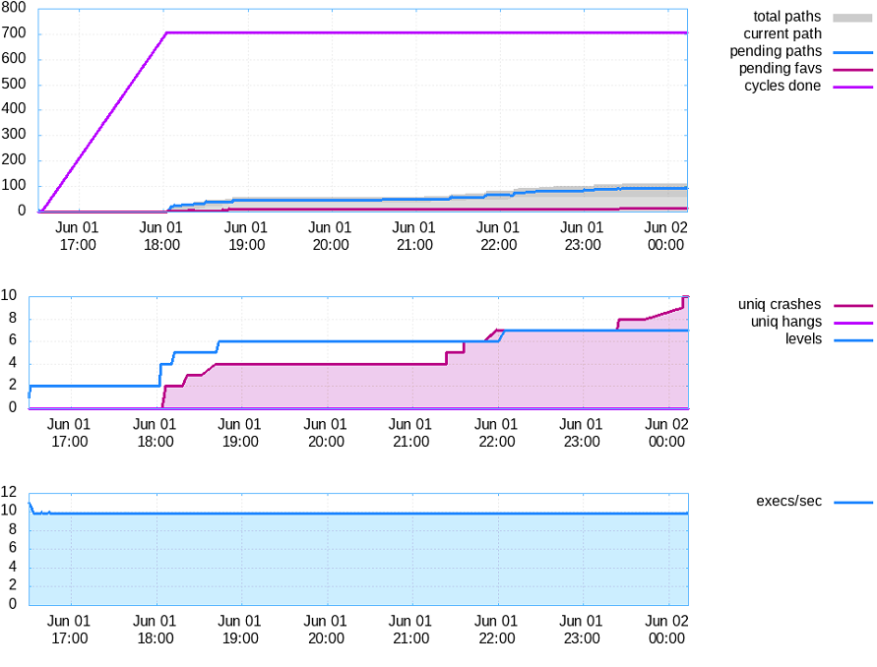
Graph

Slide 54
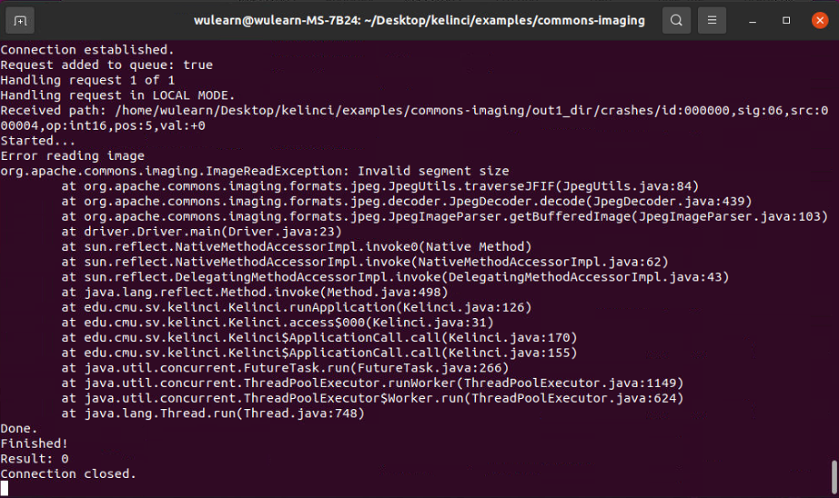
Crash

Slide 55
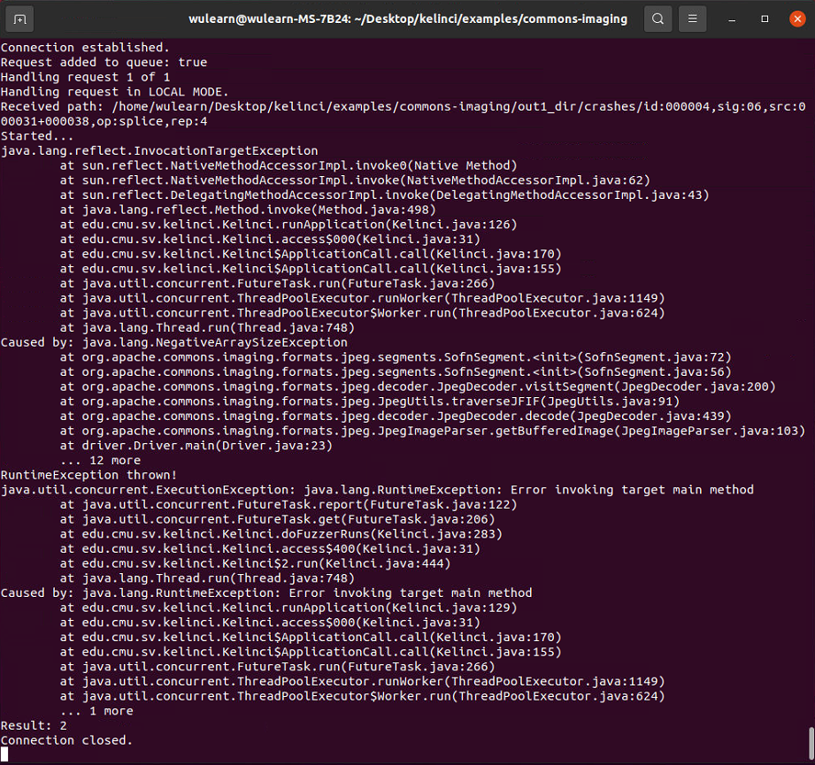
Crash

Slide 56
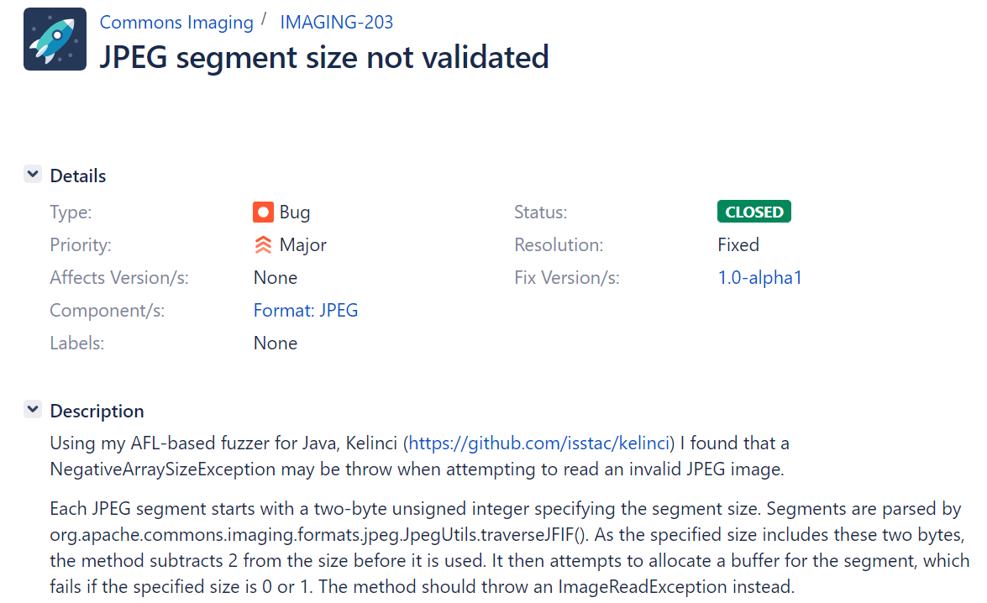
Bug report
Link: https://issues.apache.org/jira/browse/IMAGING-203

Slide 57
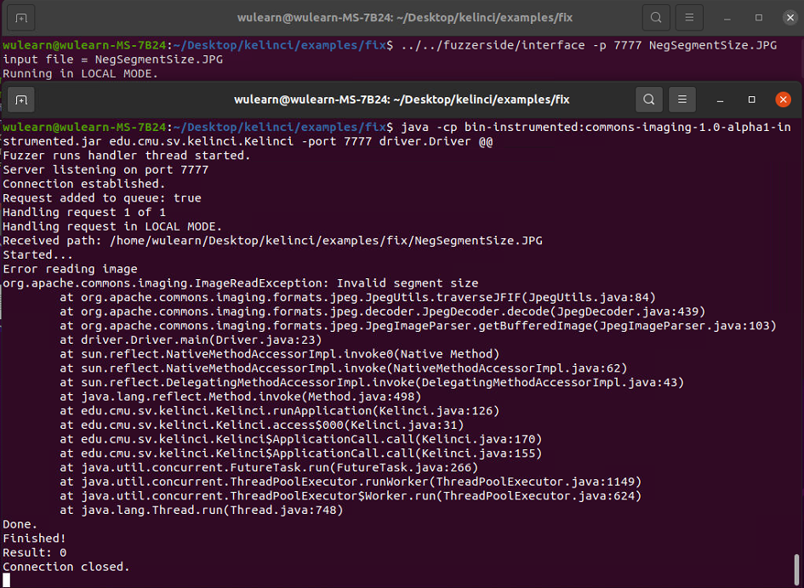
Fix bug (Version: 1.0-alpha1)

Slide 58
04.
RELATED WORK

Slide 59
Javafuzz
Coverage-guided fuzzer
Testing Java packages
2019 release
Instrumentation
LLVM-style edge coverage instrumentation (JaCoCo)
Focuses on mutations producing buffer array
Based on
go-fuzz

Slide 60
Javafuzz
JQF
Coverage-guided fuzzer
Testing Java packages
2019 release
Instrumentation
LLVM-style edge coverage instrume (JaCoCo)
Focuses on mutations producing buffer
ISSTA 2019
A tool
enable coverage-guided fuzzing
Fuzzing on Java test (Junit)
Depends on quickcheck
Based on
go-fuzz
Based like
libFuzzer

Slide 61

Javafuzz
JQF
Jazzer
Coverage-guided fuzzer
For the JVM platform
2021 release
Instrumentation
LLVM-style edge coverage instrumentation (JaCoCo)
Previously, used AFL-style coverage instrumentation as pioneered by kelinci
Integrated into OSS-Fuzz
Found 5 CVEs (2021)
Coverage-guided fuzzer
Testing Java packages
2019 release
Instrumentation
LLVM-style edge coverage instrume (JaCoCo)
Focuses on mutations producing buffer
ISSTA 2019
A tool
enable coverage-guided fuzzing
Fuzzing on Java test (Junit)
Depends on quickcheck
Based on
go-fuzz
Based like
libFuzzer
Based on
libFuzzer

Slide 62
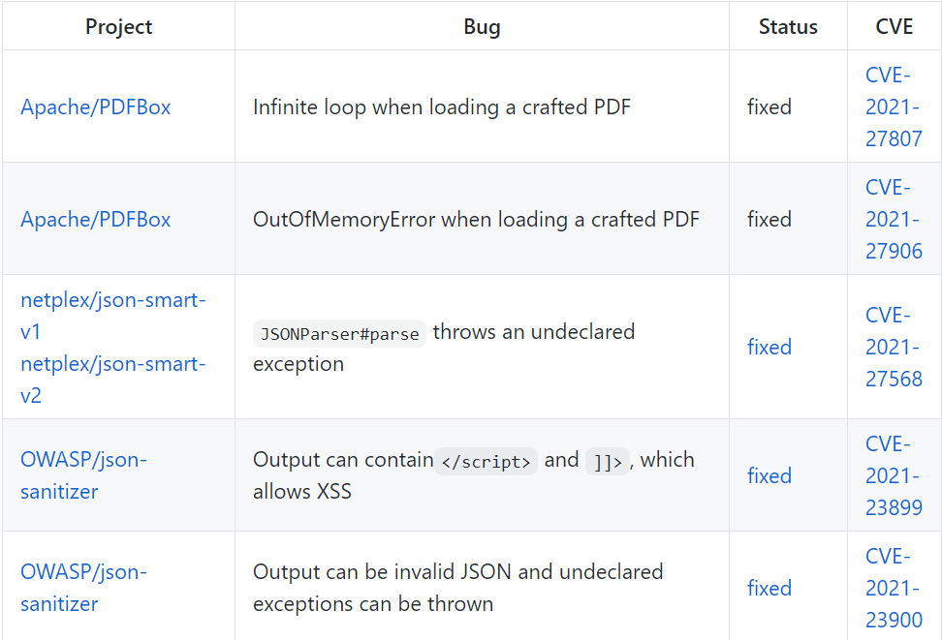
Javafuzz
JQF
Jazzer
Coverage-guided fuzzer
For the JVM platform
2021 release
Instrumentation
LLVM-style edge coverage instrumentation (JaCoCo)
Previously, used AFL-style coverage instrumentation as pioneered by kelinci
Integrated into OSS-Fuzz
Found 5 CVEs (2021)
Coverage-guided fuzzer
Testing Java packages
2019 release
Instrumentation
LLVM-style edge coverage instrume (JaCoCo)
Focuses on mutations producing buffer
ISSTA 2019
A tool
enable coverage-guided fuzzing
Fuzzing on Java test (Junit)
Depends on quickcheck
Based on
go-fuzz
Based like
libFuzzer
Based on
libFuzzer

Slide 63
05.
DISCUSSION

Slide 64
DISCUSSION

Slide 65
DISCUSSION
Adds overhead

Slide 66
DISCUSSION
Adds overhead
TCP & file IO

Slide 67
DISCUSSION
Adds overhead
TCP & file IO
Very slow execution

Slide 68
DISCUSSION
Adds overhead
TCP & file IO
Very slow execution
But still works for finding bugs

Slide 69
DISCUSSION
Adds overhead
TCP & file IO
Very slow execution
But still works for finding bugs
Different threads could access the same static locations

Slide 70
DISCUSSION
Adds overhead
TCP & file IO
Very slow execution
But still works for finding bugs
Different threads could access the same static locations
A single thread

Slide 71
DISCUSSION
Adds overhead
TCP & file IO
Very slow execution
But still works for finding bugs
Different threads could access the same static locations
A single thread
Static locations may not be reset

Slide 72
DISCUSSION
Adds overhead
TCP & file IO
Very slow execution
But still works for finding bugs
Different threads could access the same static locations
A single thread
Static locations may not be reset
Solution:

Slide 73
DISCUSSION
Adds overhead
TCP & file IO
Very slow execution
But still works for finding bugs
Different threads could access the same static locations
A single thread
Static locations may not be reset
Solution:
New a JVM before fork

Slide 74
DISCUSSION
Adds overhead
TCP & file IO
Very slow execution
But still works for finding bugs
Different threads could access the same static locations
A single thread
Static locations may not be reset
Solution:
New a JVM before fork
Fork all JVM before running program

Slide 75
DISCUSSION
Adds overhead
TCP & file IO
Very slow execution
But still works for finding bugs
Different threads could access the same static locations
A single thread
Static locations may not be reset
Solution:
New a JVM before fork
Fork all JVM before running program

Slide 76
06.
CONCLUSION

Slide 77
CONCLUSION

Slide 78
CONCLUSION
Pioneer of the AFL-style coverage instrumentation

Slide 79
CONCLUSION
Pioneer of the AFL-style coverage instrumentation
Discovered a bug

Slide 80
CONCLUSION
Pioneer of the AFL-style coverage instrumentation
Discovered a bug
APACHE COMMONS IMAGING (1.0-RC7)

Slide 81
CONCLUSION
Pioneer of the AFL-style coverage instrumentation
Discovered a bug
APACHE COMMONS IMAGING (1.0-RC7)
Can parallelization

Slide 82
CONCLUSION
Pioneer of the AFL-style coverage instrumentation
Discovered a bug
APACHE COMMONS IMAGING (1.0-RC7)
Can parallelization
Start an instance for every core

Slide 83
CONCLUSION
Pioneer of the AFL-style coverage instrumentation
Discovered a bug
APACHE COMMONS IMAGING (1.0-RC7)
Can parallelization
Start an instance for every core

Slide 84

THANK YOU

